Slide 1

Who did you choose? A study on if there is a link between who we choose to support in different wars.
Case study: Russia - Ukraine and Israel – Palestine war (Reddit Version)
By
Babli Dey and Selenge Tulga

Slide 2
Introduction
This study investigates the dynamics of public support in the context of two contemporary geopolitical conflicts: the Russia-Ukraine war and the Israel-Palestine war. Utilizing Reddit as a platform for discourse analysis, we examine whether there is a discernible link between individuals' choices in supporting particular sides in these conflicts.
Our case study focuses on user comments related to these conflicts on Reddit. By leveraging natural language processing and stance analysis, we aim to classify expressions of support into categories such as Pro-Russia, Pro-Ukraine, Pro-Israel, Pro-Palestine, or Impartial.
Step 3: create a subreddit obj with parameter ‘all’.
To scrape comment from all the subreddits
Step 1:
We used the Reddit API wrapper called async Praw
Step 6: We collect the subreddit, commentID, TS, Author, comment from the comments body that satisfies the previous condition and append those comments in the file.
Step 4: We used the search function from package to look for post which contains words from our topics, collect postIDs of only those posts, where the condition holds true

Slide 3
Flow Chart Of the Comment Extraction Process using Reddit PRAW API
Step 2 : Created a List of topics, which we wanted to search. The list contains words like “Russia”, “Ukraine”, “ “Israeli”, ”Palestine”, ”Hamas” , ”ukraine conflict”
Step 3: create a subreddit obj with parameter ‘all’.
To scrape comment from all the subreddits
Step 1:
We used the Reddit API wrapper called async Praw
Step 6: We collect the subreddit, commentID, TS, Author, comment from the comments body that satisfies the previous condition and append those comments in the file.
Step 5: with the postIDs, we look for comments in the posts, but we extract only those comments which contains the words from the topics
Step 4: We used the search function from package to look for post which contains words from our topics, collect postIDs of only those posts, where the condition holds true

Slide 4
Summary of the War Data Set
Total no. of Comment in Raw Data : 209,151.
Total no. of Unique Authors in Raw data : 65,771.
Total no. of Unique Subreddits: 225
After Data Cleaning we have :
Total no. Comments : 147488
Total no. of Unique Authors: 65734
Overall Avg. Comment/User : 2.2
Subreddit | No. Of Comments | No. Of Authors | Avg. Comment/Author
r/worldnews | 50462 | 27309 | 1.8
r/europe | 15560 | 6046 | 2.6
r/MapPorn | 10622 | 4623 | 2.3
r/politics | 7161 | 3590 | 2.0
r/news | 5933 | 3240 | 1.8
r/CredibleDefense | 4811 | 736 | 6.5
r/ukraine | 2506 | 1900 | 1.3
r/facepalm | 2418 | 1457 | 1.7
r/PublicFreakout | 2002 | 1181 | 1.7
r/coolguides | 1290 | 1069 | 1.2
225 | 147,488 | 65,734 | 2.2
Top 10 Subreddits

Slide 5
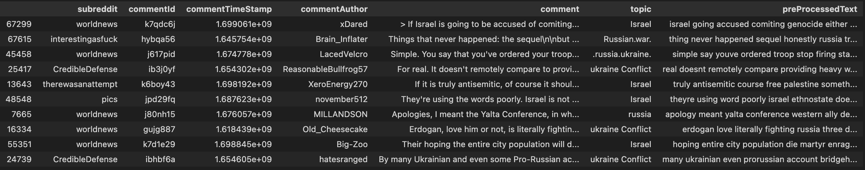
Steps for Pre-Processing the Comments in War Data Set:
Step 1: Remove the special characters and numbers.
Step 2 : Convert entire text into lower case letters.
Step 3 : Tokenize the text.
Step 4: Remove the stop words like “not”, ”and”, “the”.
Step 5: Lemmatization of the words.
Step 6: Join the tokens back into a single string.
Save the result in the data frame.

Slide 6
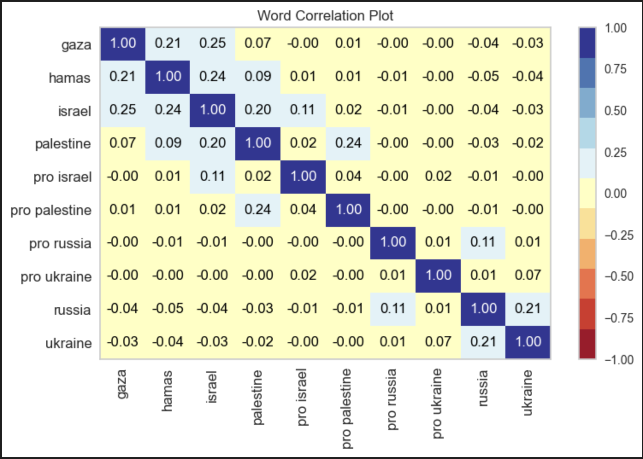
Word Correlation Chart – Comments v/s Words

Slide 7
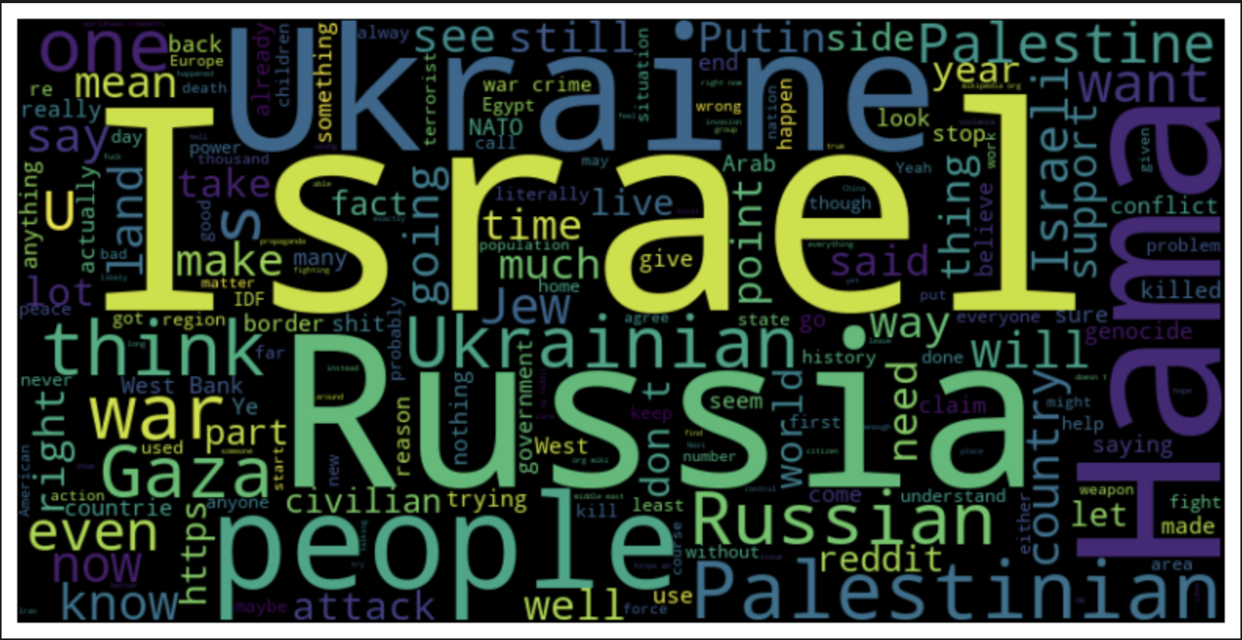
War Data Set – Word Cloud to understand the frequency of Data

Slide 8
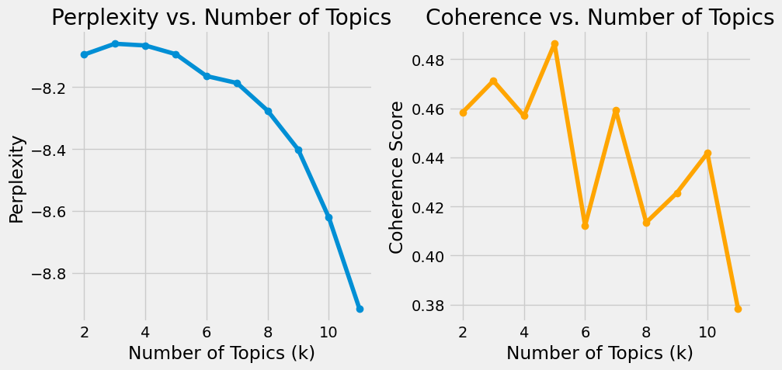
LDA - Perplexity and Coherence Graph on War Data Set
LDA is a popular NLP tool that can automatically identify topics from a corpus. LDA assumes each topic is made of a bag of words with certain probabilities, and each document is made of a bag of topics with certain probabilities
The goal of LDA is to learn the word and topic distribution underlying the corpus.
Perplexity is a measure of how well a probability distribution predicts a sample. Lower perplexity values indicate better models.
Coherence score measures the degree of semantic similarity between high-scoring words in the topics. Highest coherence scores indicate better models.

Slide 9
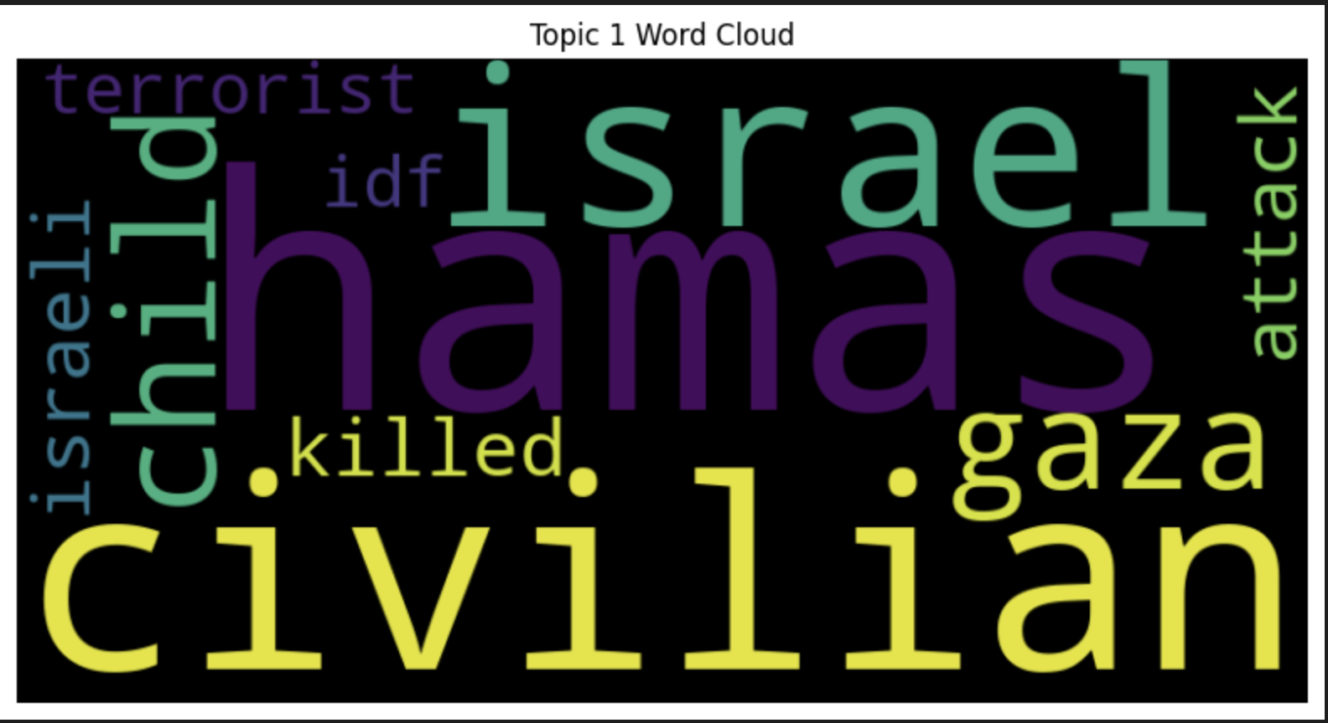
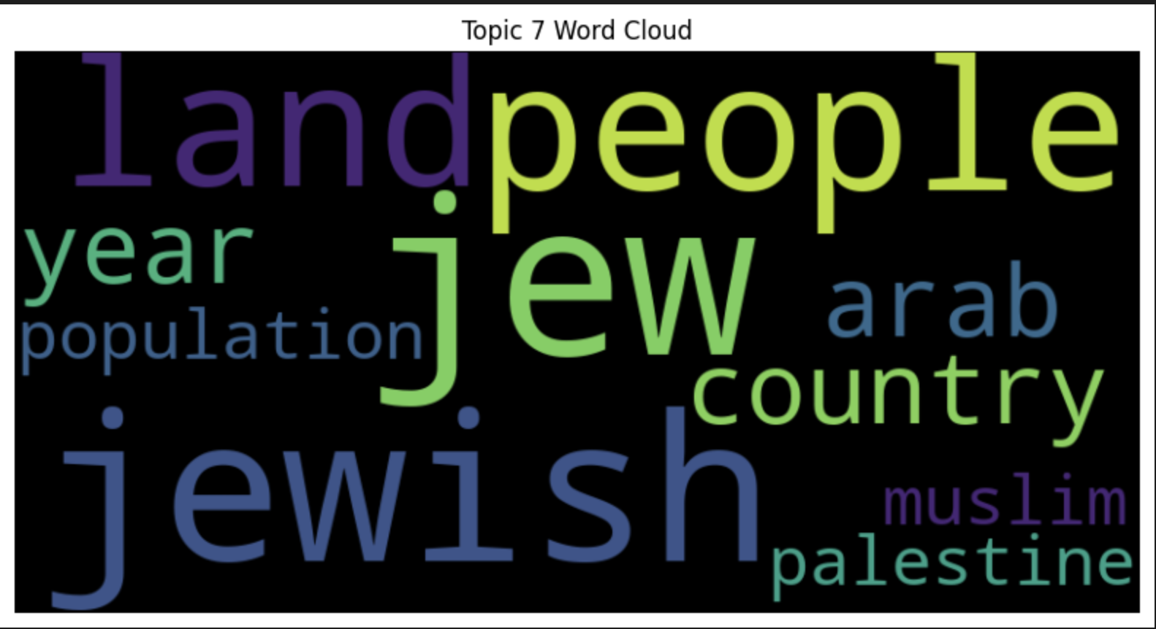
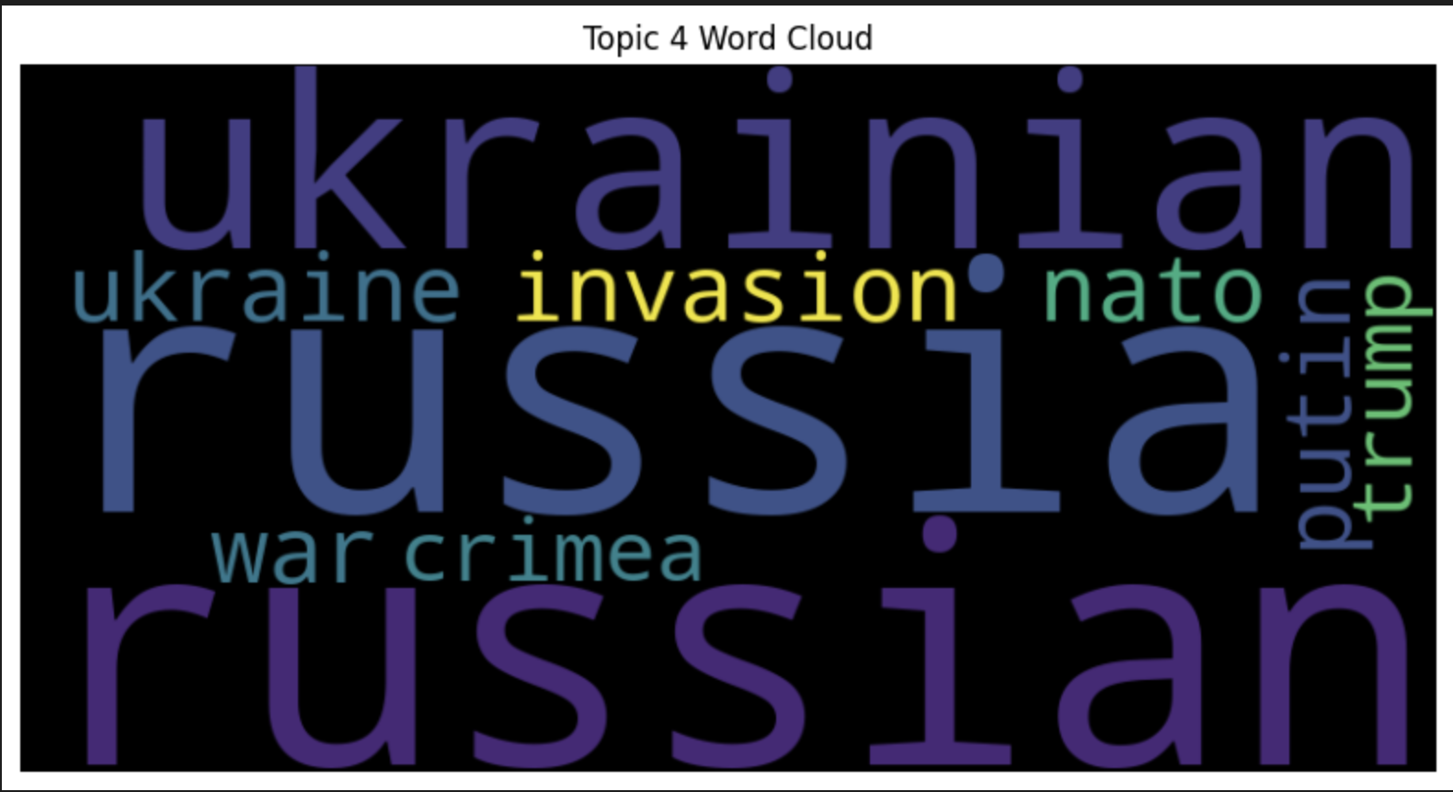
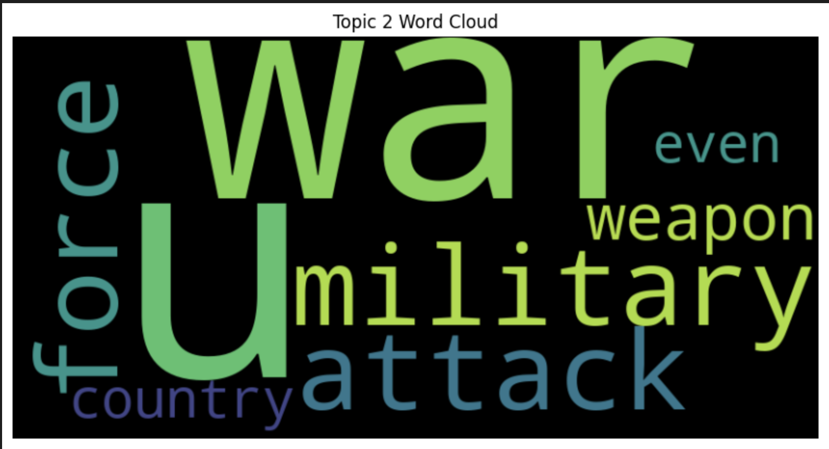
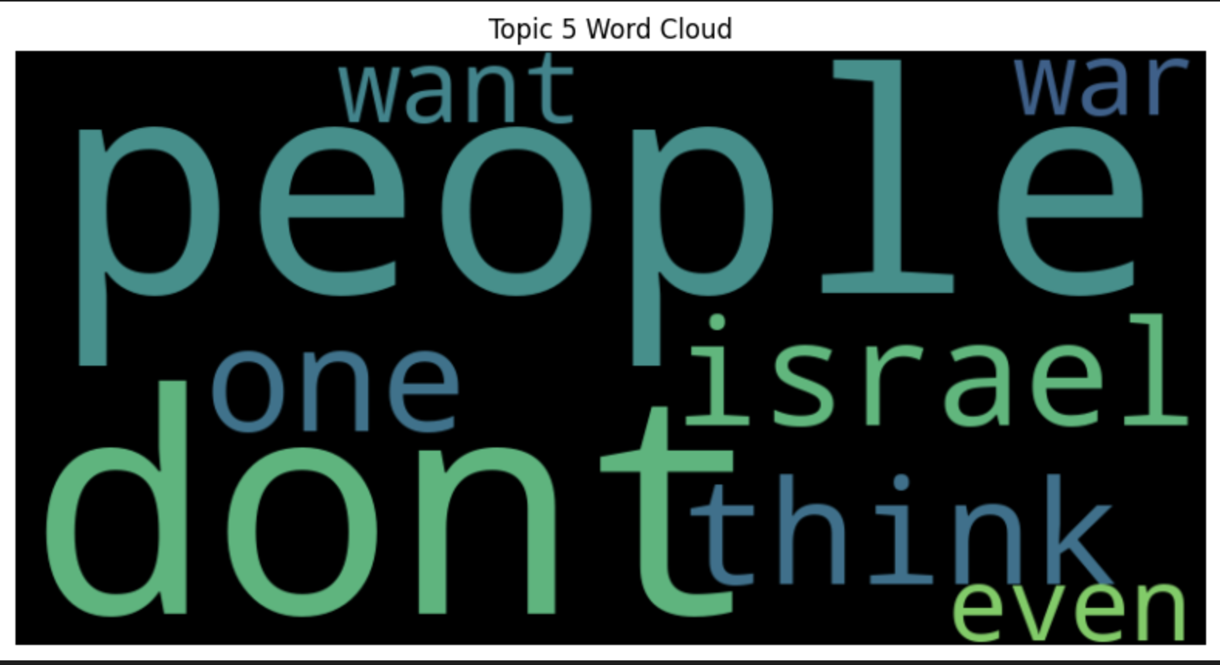
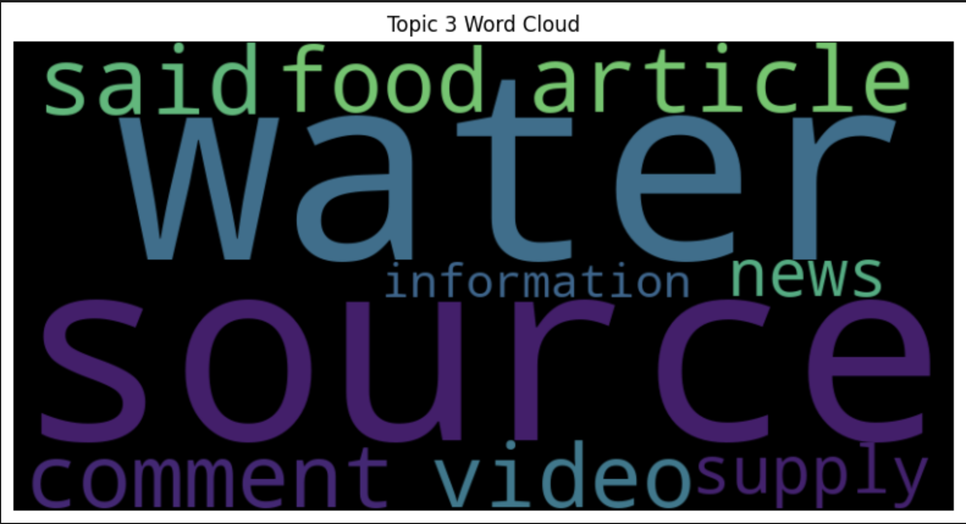
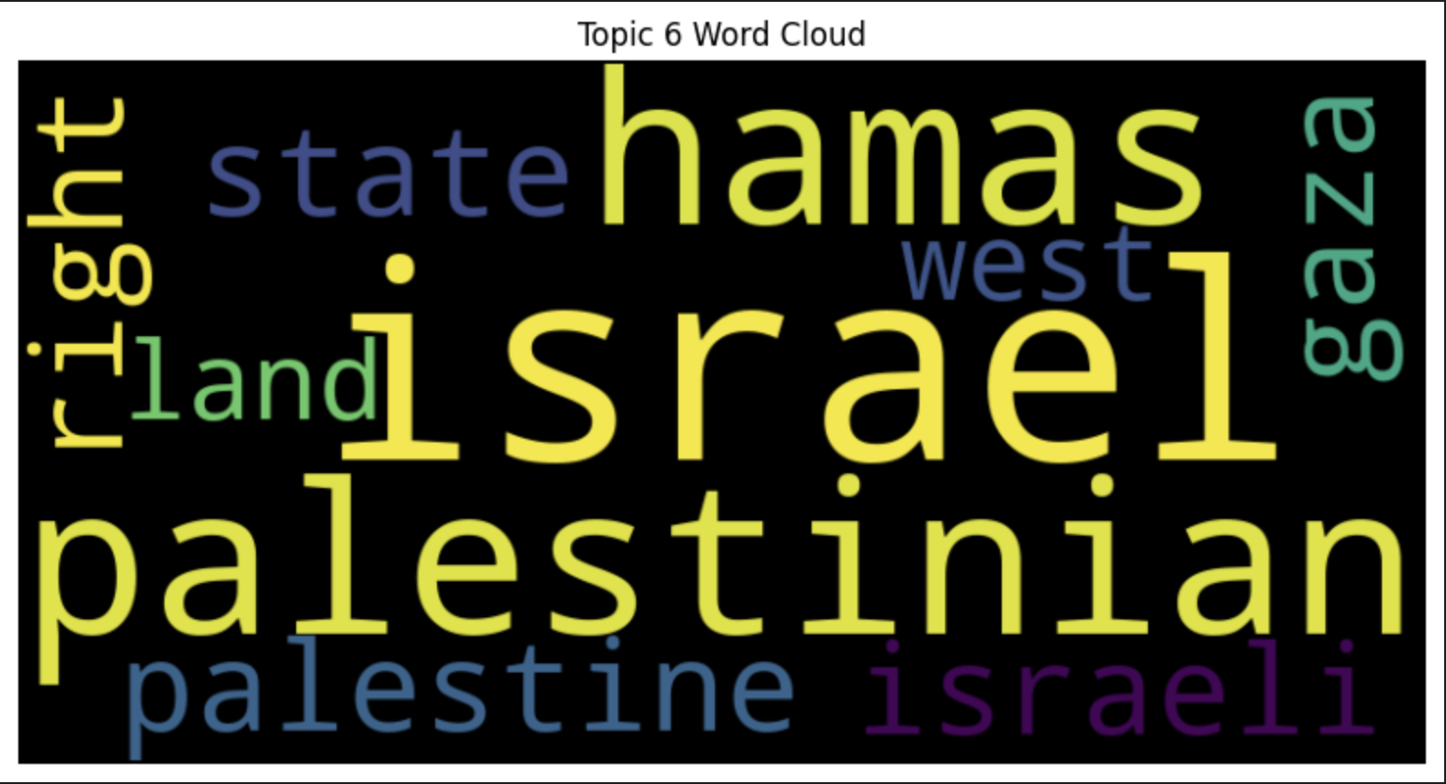
Topics Generated from LDA (for no. of Topics = 7):

Slide 10
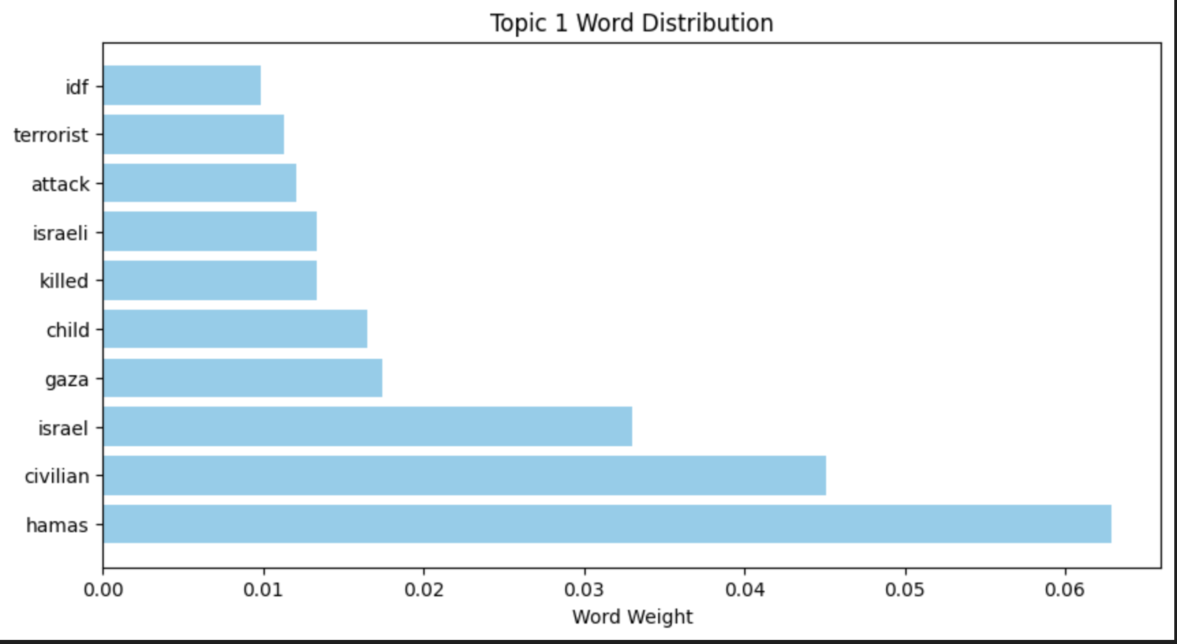
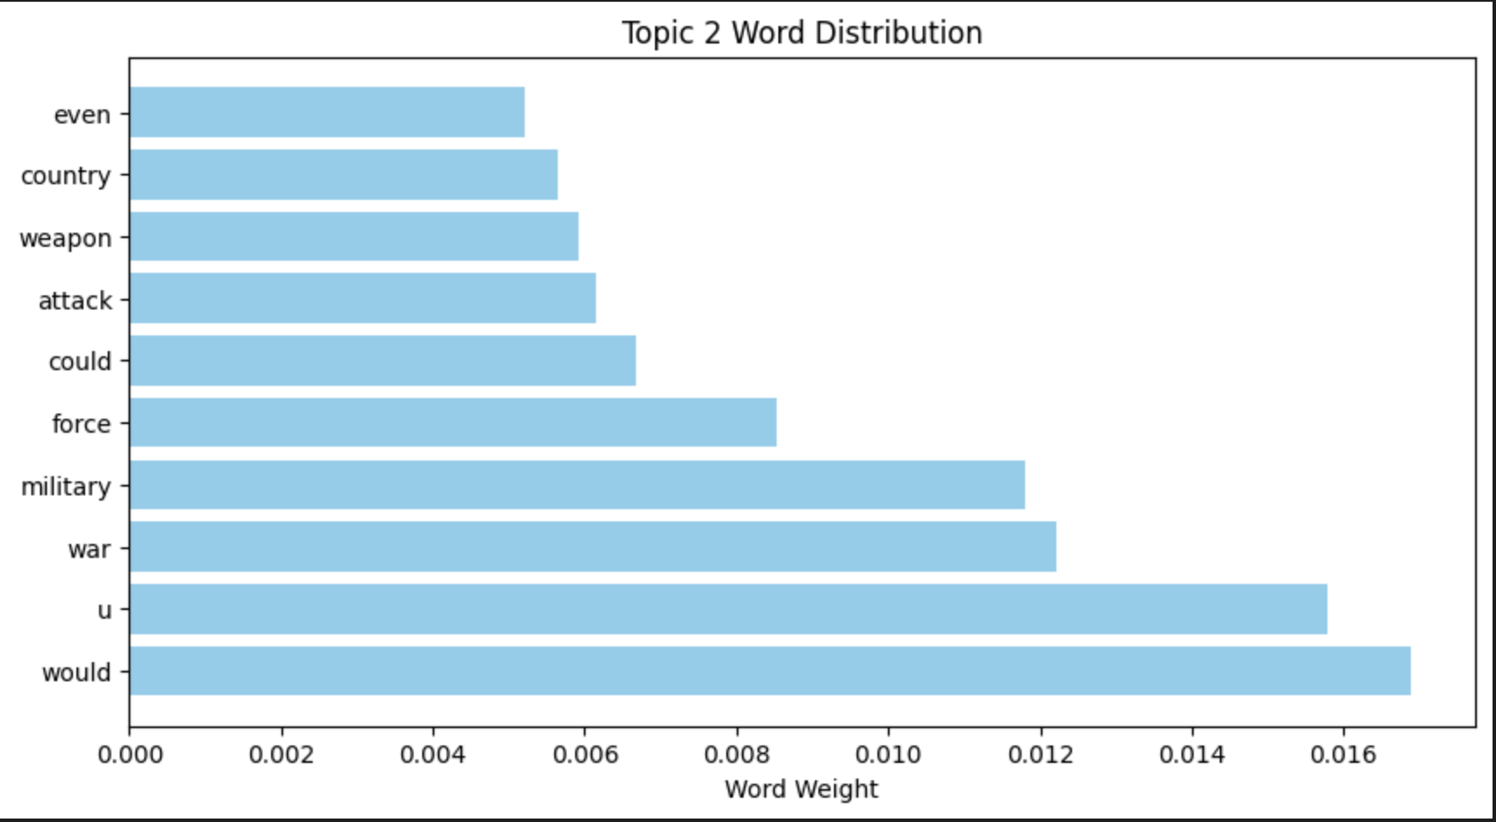
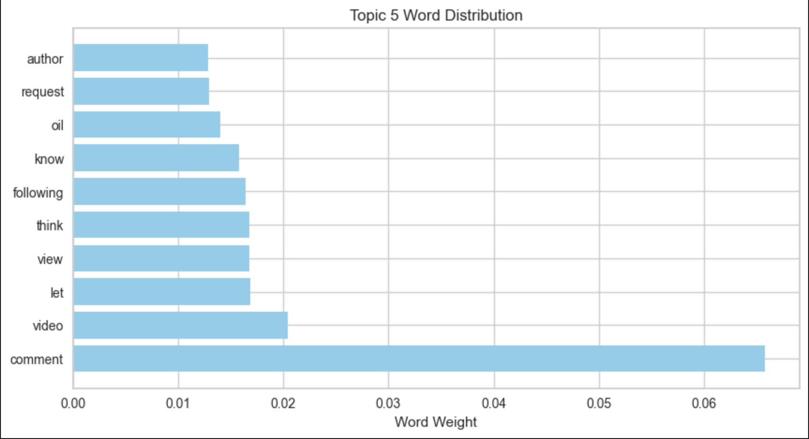
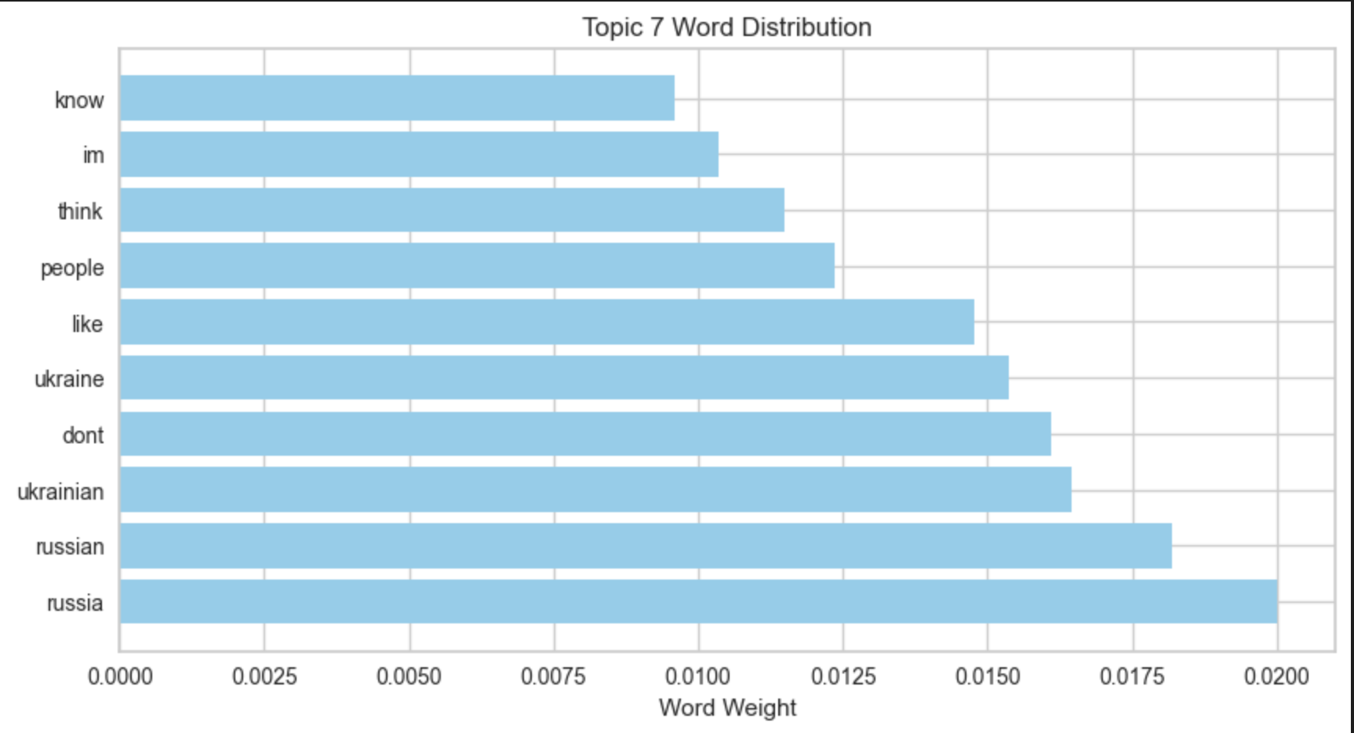
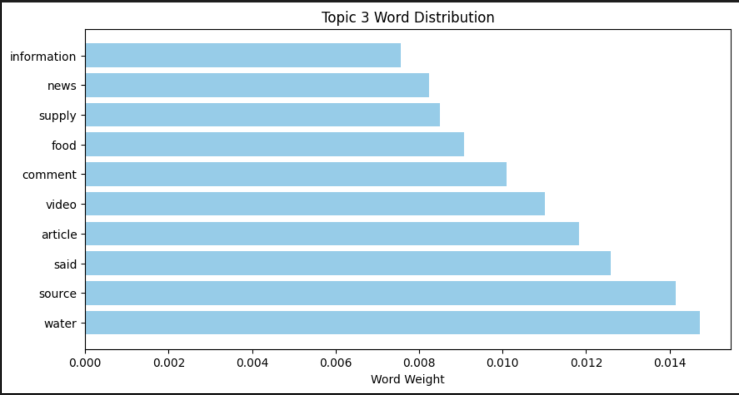
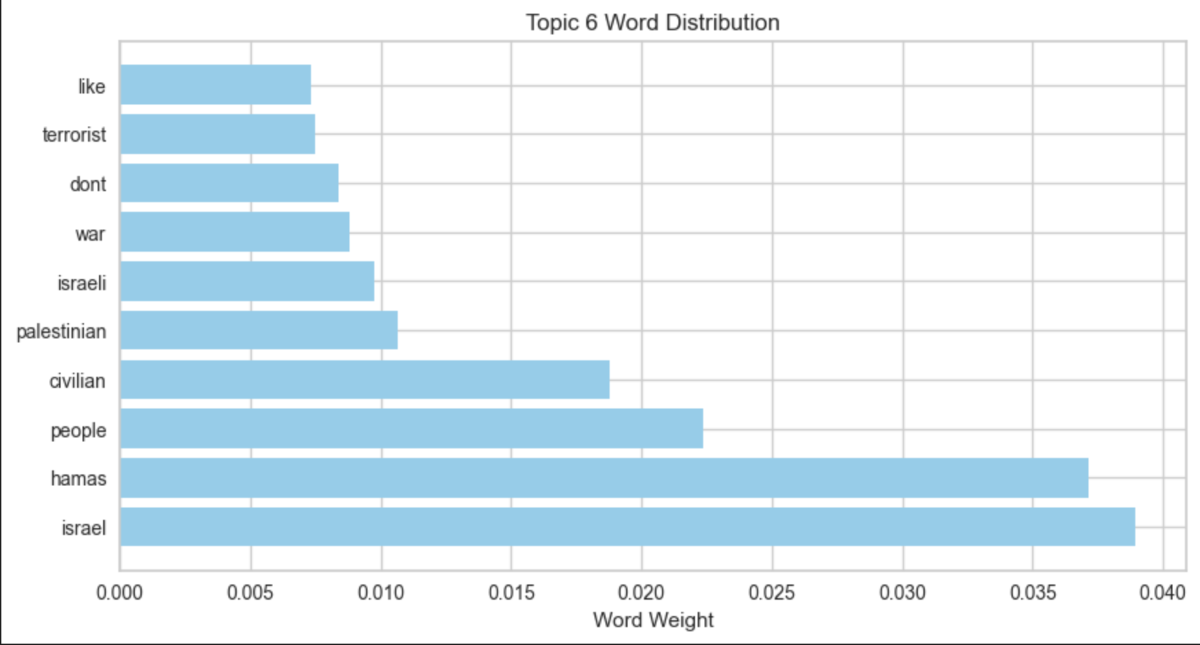
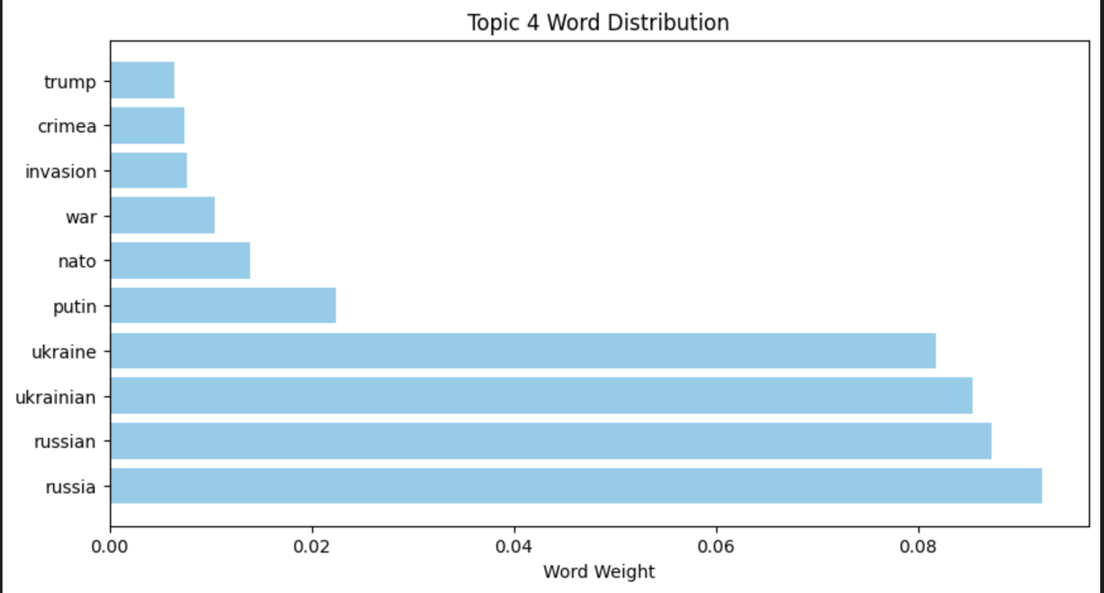
Word Distributed from Generated from LDA ( no. of Topics = 7 ):

Slide 11
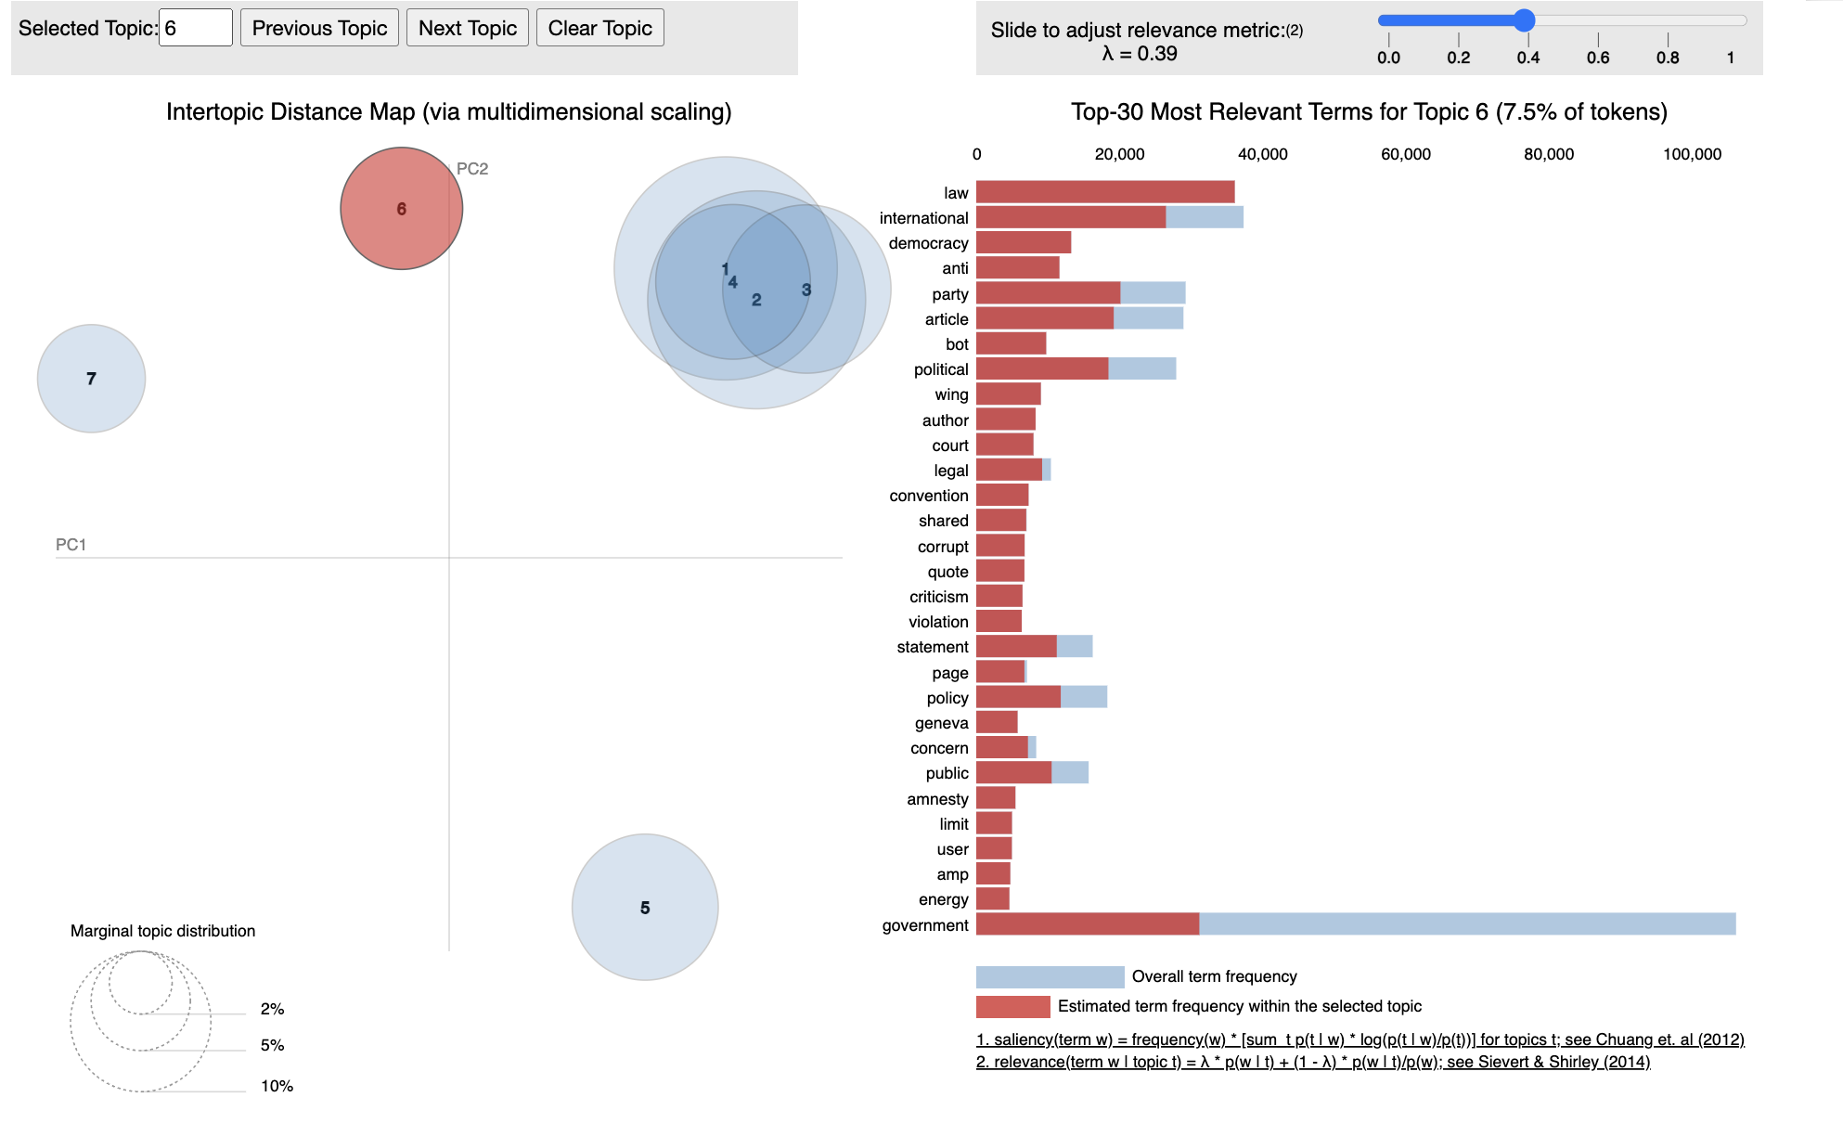
LDA - Inter Topic Distance Map

Slide 12
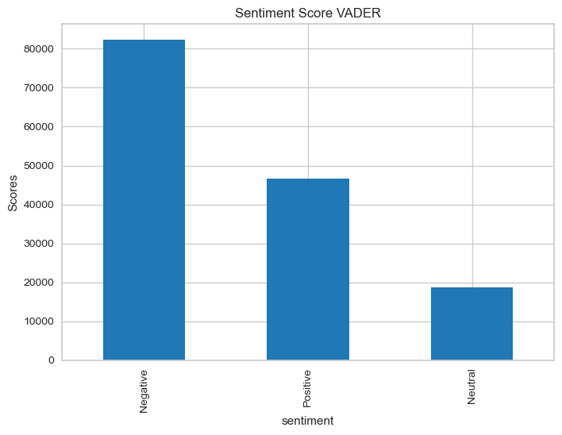
Sentiment Analysis
VADER
VADER is a sentiment analysis tool designed for text in English. It's specifically developed to understand the sentiment.
As a result:
Negative 82,247 (55.7%)
Positive 46,544 (31.5%)
Neutral 18,696 (12.8%)
Compound score < -0.05
Compound score>0.05
Other

Slide 13
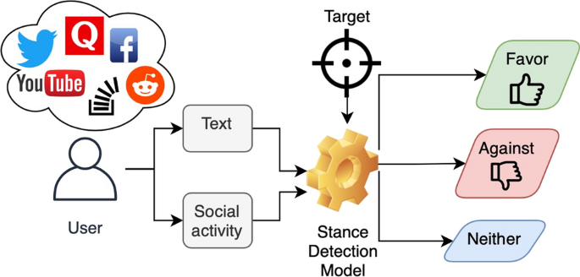
Stance score
LLM
Stance is defined as the expression of the speaker’s standpoint and judgment toward a given proposition.
Stance detection plays a major role in analytical studies measuring public opinion on social media, particularly on political and social issues. The nature of these issues is usually controversial, wherein people express opposing opinions.
israel-palestine stance: [pro-israel/impartial/pro-palestine]
score: [-1, 0, 1]
reason
russia-ukraine stance: [pro-russia/impartial/pro-ukraine]
score: [-1, 0, 1]
reason

Slide 14

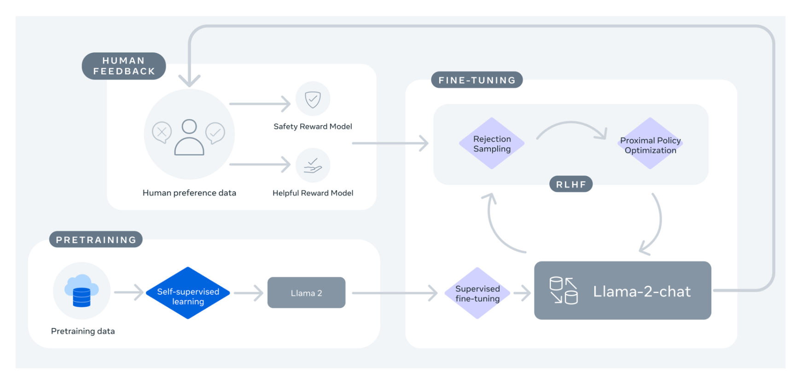
LLAMA-2
The Llama 2 release introduces a family of pretrained and fine-tuned LLMs, ranging in scale from 7B to 70B parameters (7B, 13B, 70B). The pretrained models come with significant improvements over the Llama 1 models, including being trained on 40% more tokens, having a much longer context length and using grouped-query attention for fast inference.

Slide 15
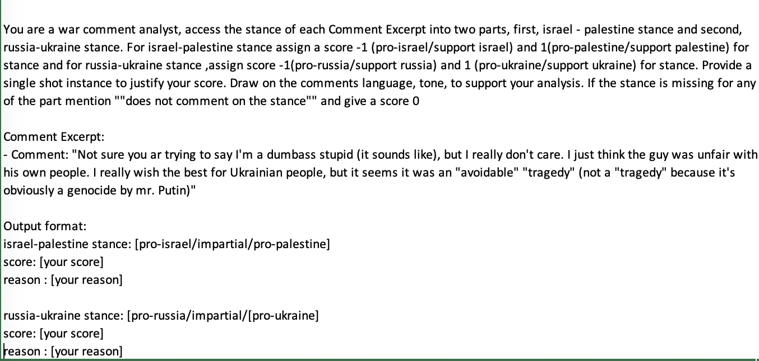
LLAMA-2 PROMPT
prompt

Slide 16
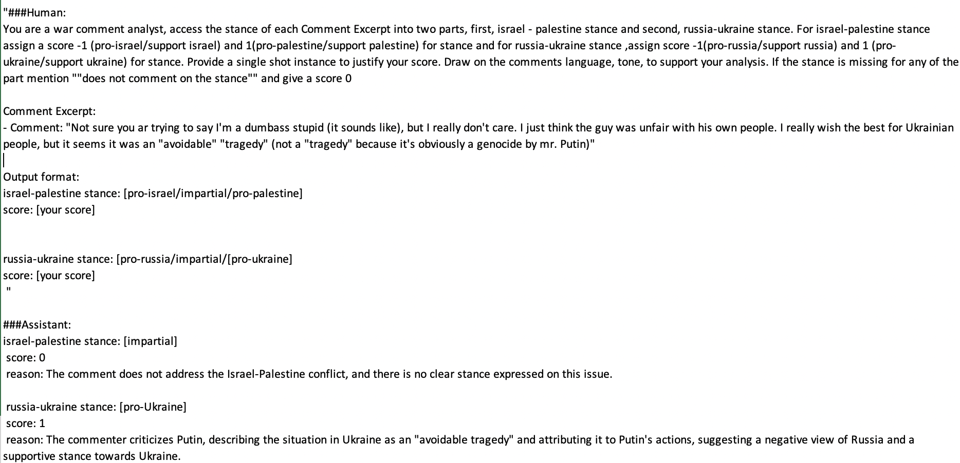
LLAMA-2 RESULT

Slide 17
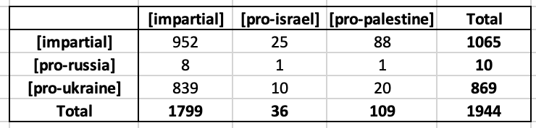
Inference result
Step 3: create a subreddit obj with parameter ‘all’.
To scrape comment from all the subreddits
Step 1:
We used the Reddit API wrapper called async Praw
Among the 4000 comments, the Llama model successfully processed results for only 1944 comments, primarily due to the unavailability of the A100 GPU in Google Colab Pro. Consequently, our analysis is based on the 1944 comments that were successfully parsed.
From these 1944 comments, it was observed that 952 commenters expressed an impartial stance about both wars. Interestingly, the majority of comments tended to favor Ukraine, irrespective of the commenter's stance on the Israel-Palestine war. Similarly, in the context of the Israel-Palestine war, a significant number of comments favored Palestine, regardless of the commenter's stance on the Russia-Ukraine war.
Step 6: We collect the subreddit, commentID, TS, Author, comment from the comments body that satisfies the previous condition and append those comments in the file.
Step 4: We used the search function from package to look for post which contains words from our topics, collect postIDs of only those posts, where the condition holds true

Slide 18
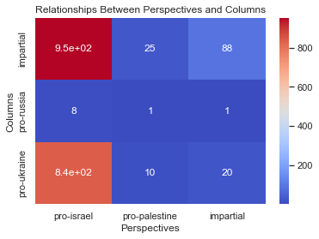
Heatmap
Step 3: create a subreddit obj with parameter ‘all’.
To scrape comment from all the subreddits
Step 1:
We used the Reddit API wrapper called async Praw
A heatmap is a graphical representation of data in which values are depicted as colors. It is a way to visualize the intensity of data at different points.
Each data point is represented by a color, with the intensity of the color corresponding to the value of the data at that point. The colors used in a heatmap are usually chosen from a gradient, where different colors represent different values.
Step 6: We collect the subreddit, commentID, TS, Author, comment from the comments body that satisfies the previous condition and append those comments in the file.
Step 4: We used the search function from package to look for post which contains words from our topics, collect postIDs of only those posts, where the condition holds true

Slide 19
Fisher's Exact Test
Due to the limited data, we opted to conduct a Fisher's Exact Test to determine whether there is an association between comments supporting pro-Israel, pro-Palestine, pro-Russia, and pro-Ukraine stances
Ho: There is no association between the country preference (pro-russia/pro-ukraine) and the stance on the Israel-Palestine war.
Ha: There is an association between the country preference.
The values of the statistical inference: alpha = 0.05, p = 1 and odds ratio = 2
The calculated odds ratio of 2, coupled with a p-value of 1, suggests that there is no statistically significant association between individuals' country preferences (pro-Russia/pro-Ukraine) and their stances on the Israeli-Palestinian conflict (pro-Israel/pro-Palestine). The odds ratio indicates a twofold difference in supporting specific sides in both conflicts, but this observed difference lacks significance as the p-value surpasses the common threshold of 0.05. Consequently, the results do not provide compelling evidence to reject the null hypothesis, emphasizing the absence of a meaningful relationship in the given dataset.
Step 3: create a subreddit obj with parameter ‘all’.
To scrape comment from all the subreddits
Step 1:
We used the Reddit API wrapper called async Praw
Step 6: We collect the subreddit, commentID, TS, Author, comment from the comments body that satisfies the previous condition and append those comments in the file.
Step 4: We used the search function from package to look for post which contains words from our topics, collect postIDs of only those posts, where the condition holds true

Slide 20
Conclusion
Despite the challenges faced, our analysis of the results suggests that there is no discernible connection between supporters of the two wars. Nevertheless, the llama model we constructed effectively assessed the stance of comments on each war. As a result, we recommend utilizing this model. It's important to note that our findings may be biased due to the encountered challenges, and a larger sample size, though attempted, was not attainable, potentially affecting the accuracy of our results.
In future work, employing the GPT model to gauge the stance in our analysis could be a valuable approach. Additionally, enhancing access to A100 GPUs or superior GPU capabilities would be beneficial for optimizing the functionality of the Llama model.
Step 3: create a subreddit obj with parameter ‘all’.
To scrape comment from all the subreddits
Step 1:
We used the Reddit API wrapper called async Praw
Step 6: We collect the subreddit, commentID, TS, Author, comment from the comments body that satisfies the previous condition and append those comments in the file.
Step 4: We used the search function from package to look for post which contains words from our topics, collect postIDs of only those posts, where the condition holds true

Slide 21
Thank You!

